Slide 1
Submitted to:md.Moshaidul Islam
Consultant show & tell
Submitted by:Dil Nazmin
ID:1244810

Slide 2
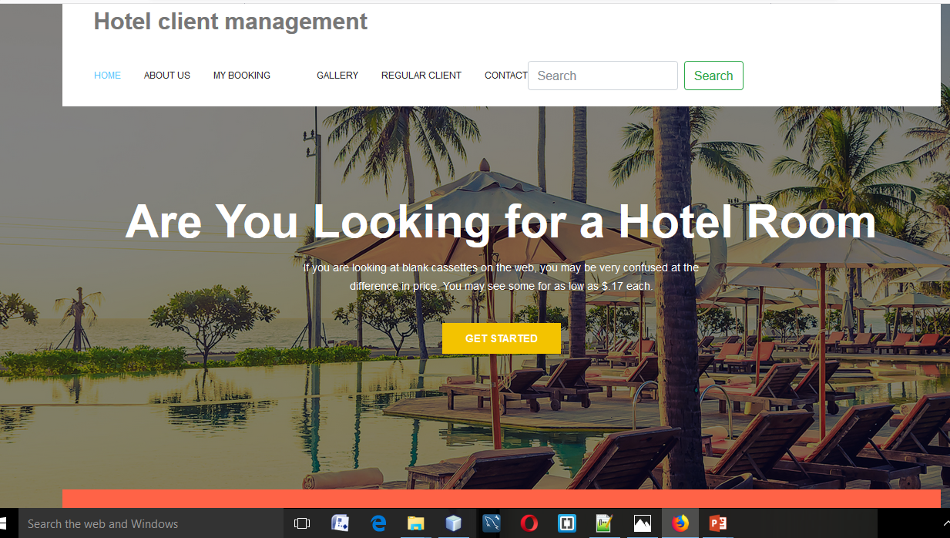

Slide 3
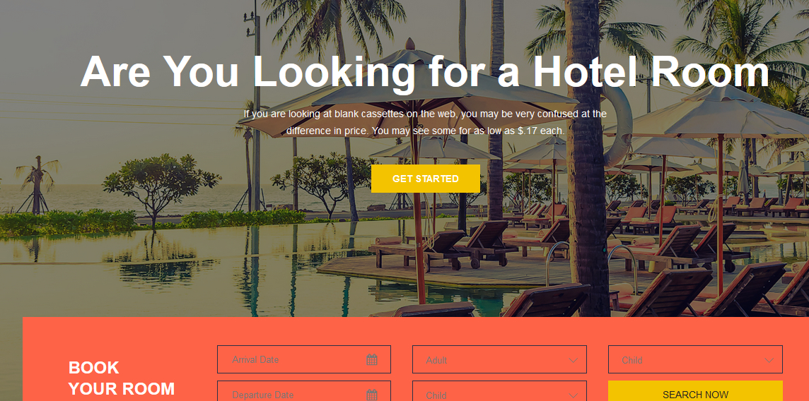

Slide 4
Hotel reservation management system is a platform to manage hotel bookings and reservations. It mainly includes: Storage and distribution of information concerning hotels, room information, bookings, reservations, guest information, stay facilities and amenities.

Slide 5
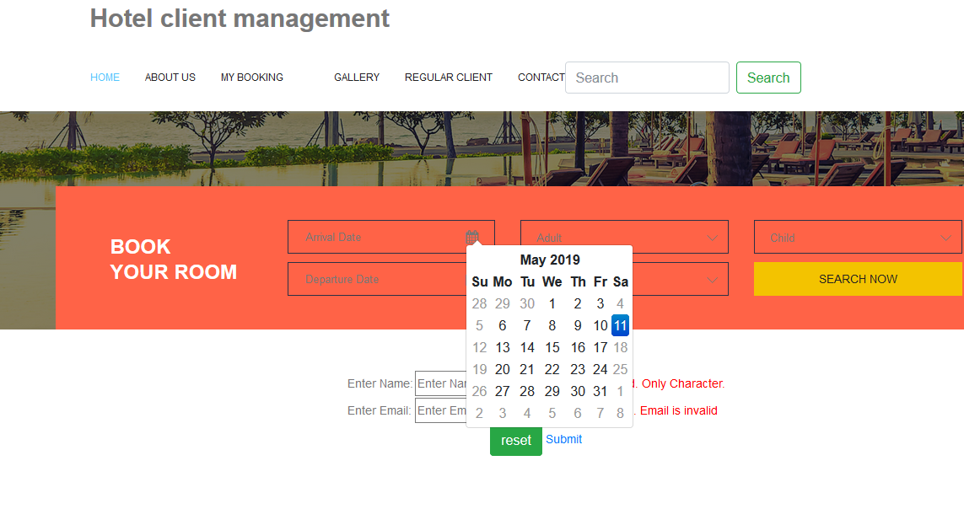

Slide 6
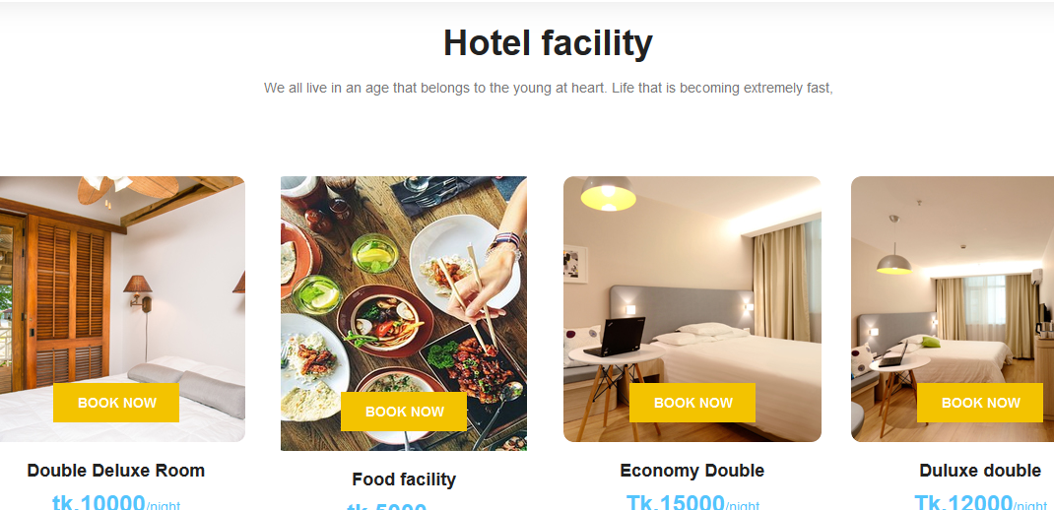

Slide 7
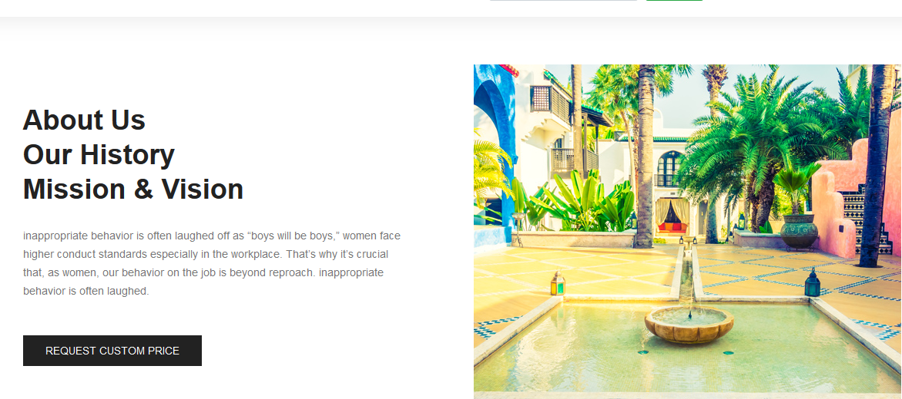

Slide 8
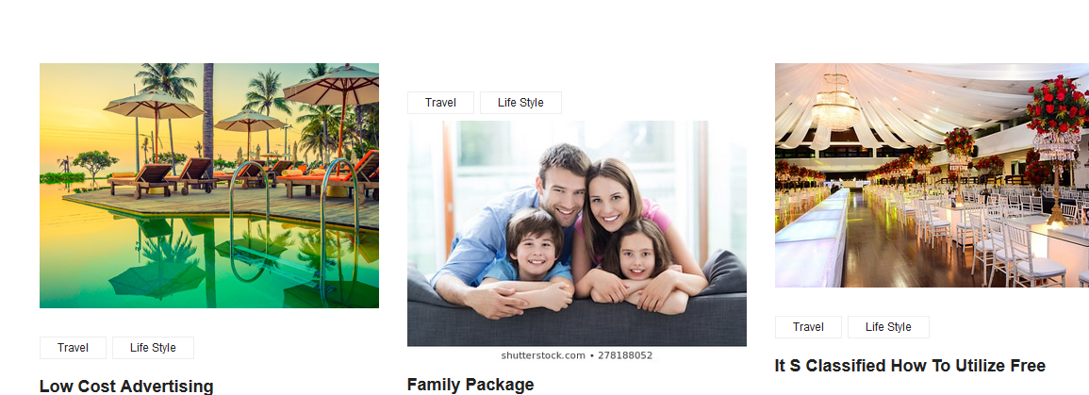

Slide 9


Slide 10


Slide 11
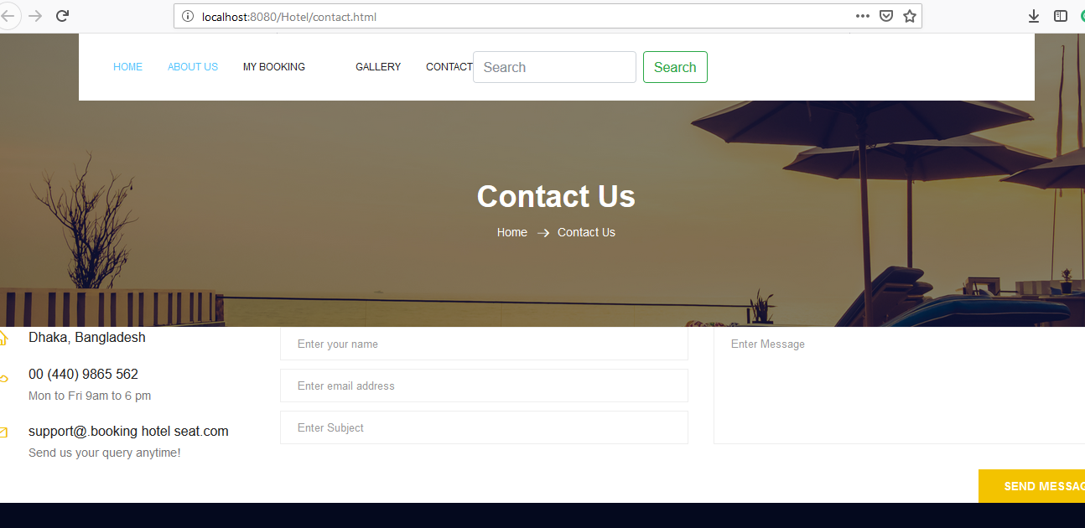

Slide 12
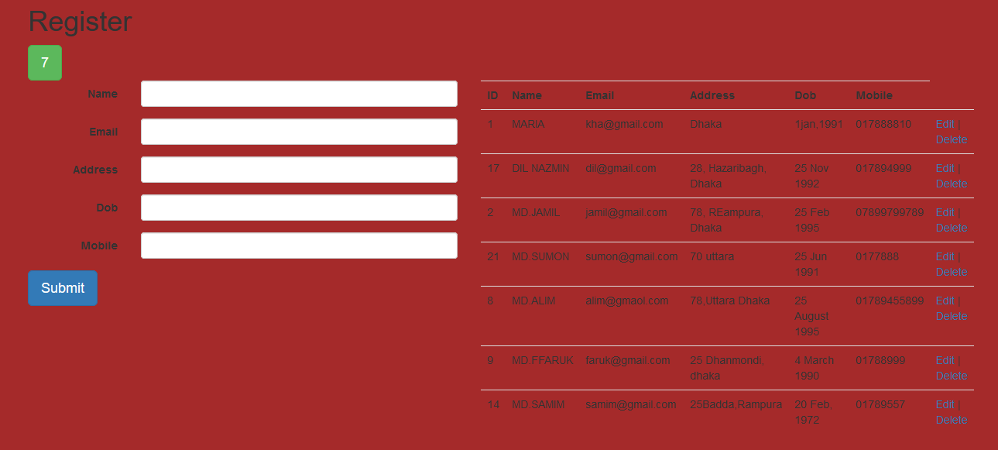

Slide 13
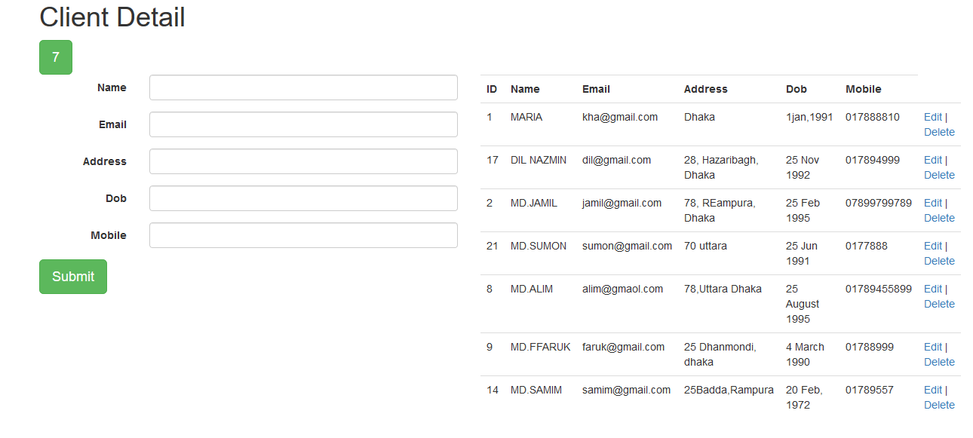

Slide 14
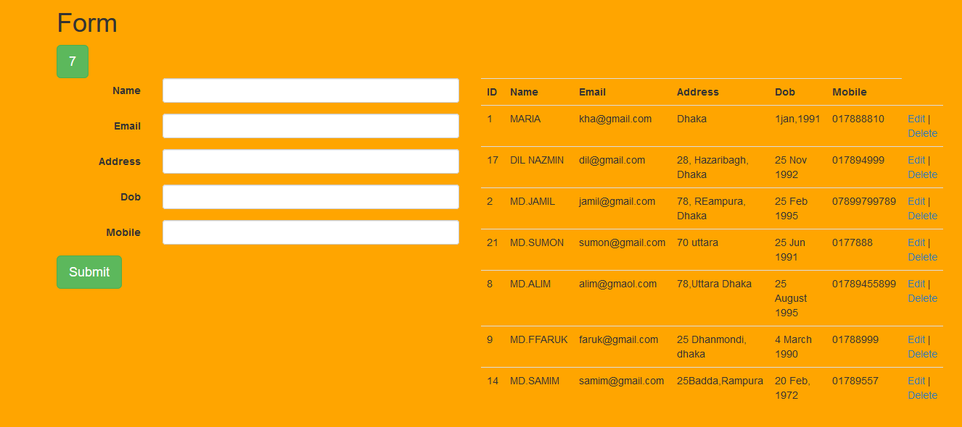

Slide 15
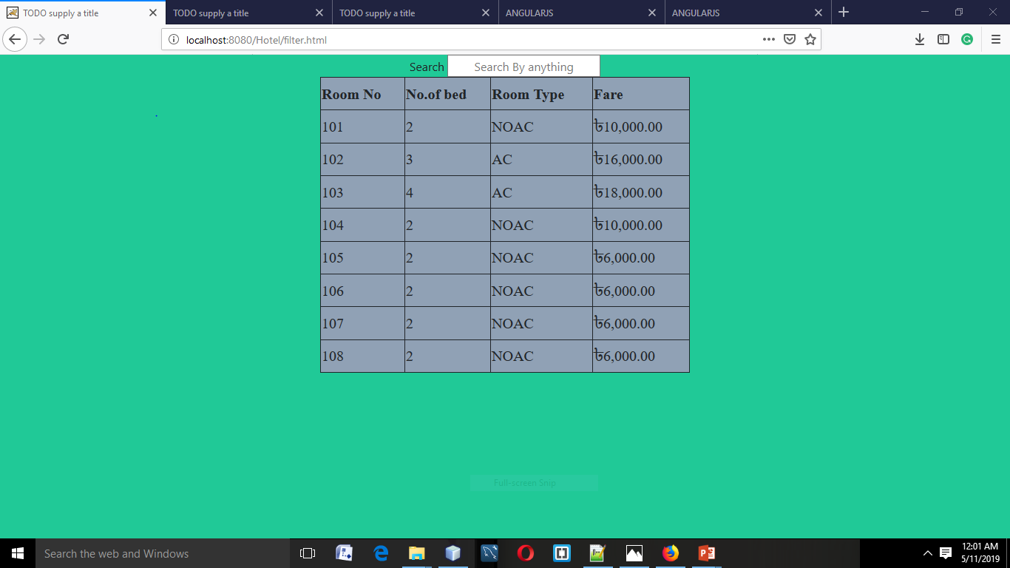

Slide 16
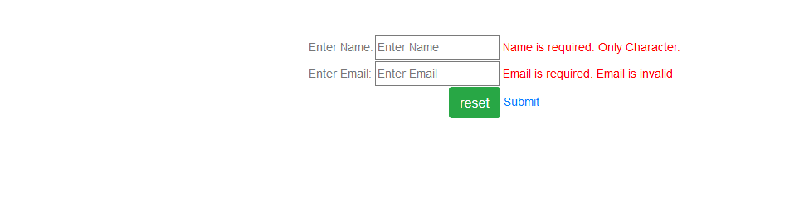

Slide 17
Using component:
Angularjs restfulwebservice
1)Hybernate
2)Angular js
3)MySql
4)Neatbean 8.13

Slide 18
Future development:
Userside
Add more facility

Slide 19
Thank You Almighty
Thanks who have seen the presentation

